Slide 1
Chapter 5
DWIA (formulation) - Figures

Slide 2
Coordinates Chosen
r
r
r’
r
2
1
r’
1
2
r
a
Projectile a
Target A
Figure 1

Slide 3
Channel Coordinates
r
r’
r’
r
1L
2L
1L
r
2L
r
a
r
rr
b
Projectile
Target
Figure 2

Slide 4
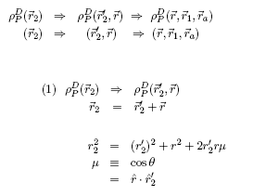
Choice of coordinate system for the projectile density expansion
[Direct part (1st step)]
r
2
r
r’
2
SUB PDENST(0)
Figure 3

Slide 5
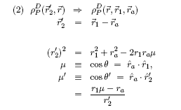
Choice of coordinate system for the projectile density expansion
[Direct part (2nd step)]
Z-axis
r’
2
r
a
r
1
SUB FFCALD
Figure 4

Slide 6
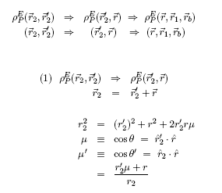
Choice of coordinate system for the projectile density expansion
[Exchange part (1st step)]
r
2
r
r’
2
SUB PDENST(1)
Figure 5

Slide 7
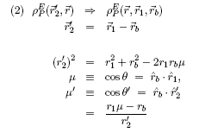
Choice of coordinate system for the projectile density expansion
[Exchange part (2nd step)]
Z-axis
r’
2
r
b
r
1
SUB FFCALE SEC. 6
Figure 6

Slide 8
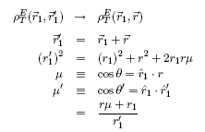
Choice of coordinate system for the target density expansion
[Exchange part]
Z-axis
r’
1
r
1
r
SUB DENST
Figure 7

Slide 9
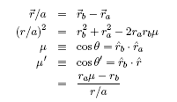
Choice of coordinate system for r-separation into r_a and r_b
[Exchange part]
Z-axis
r/a
r
b
r
a
SUB FFCALE SEC. 8
Figure 8

Slide 10
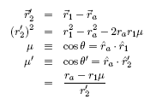
Choice of coordinate system for the form factor N-A scattering
Z-axis
r’
2
r
a
(r )
r
1
b
SUB FFCALD & FFCALE
Figure 9

Slide 11
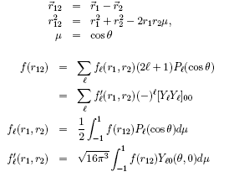
Multipole Expansion of Scalar Function
r
12
r
1
r
2
Figure 10

Slide 12
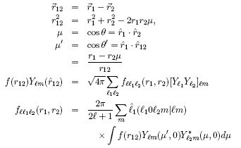
Multipole Expansion of Vector Function
Z-axis
r
12
r
1
r
2
Figure 11

